Slide 1
Outline
1. Introduction
2. Problem
3. Related Work
4. What’s New
5. Social Reputation
6. Site Agility
Image Agility
Code Agility
Data Collection
Arun graphic
7. Machine Learning
How it works
Results
Facebook Shares issue
8. Websearch API
9. Conclude

Slide 2
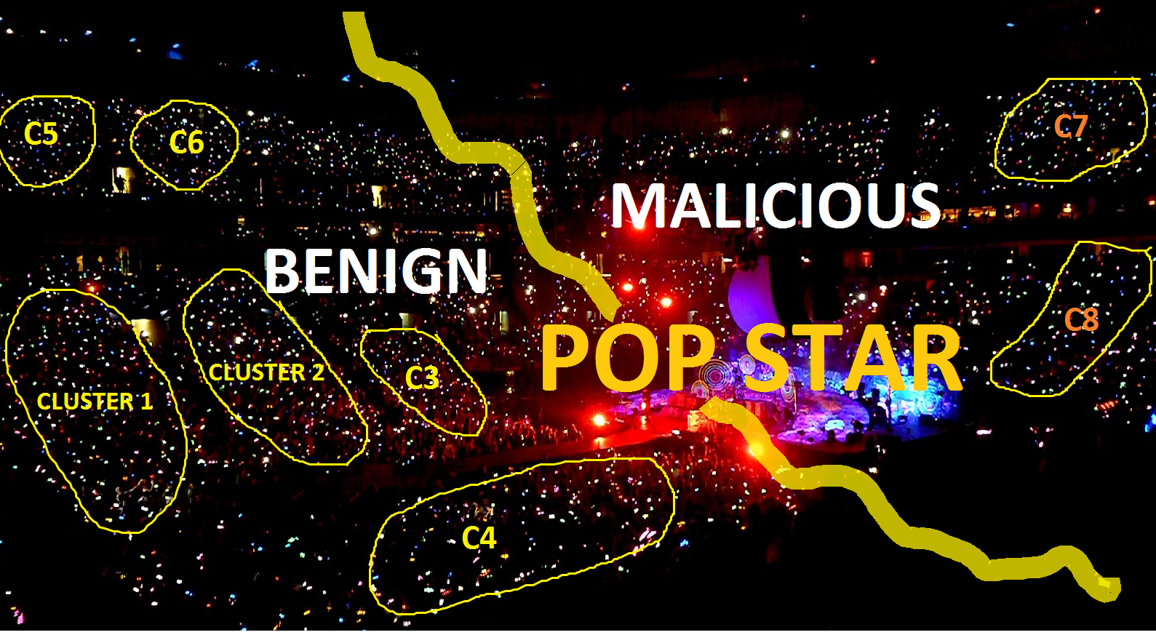
Malicious website Detection using Social Reputation and Site Agility

Slide 3
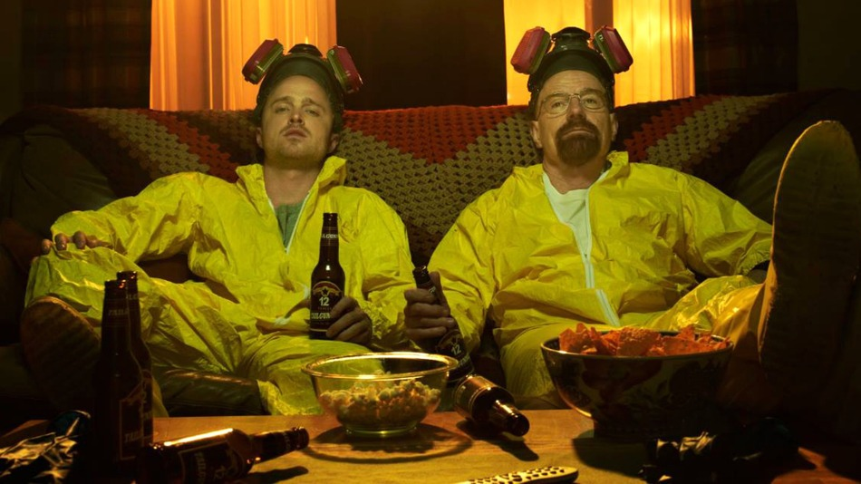
Introduction: The Dynamic Duo
PopStar: A Malicious Website Detection System
PopRank: Water Holing Web Spam Link Detection

Slide 4
The Problem
Finding an Innovative Approach to Malicious Website Detection

Slide 5

Previous work
Website classification based on:-
Dynamic Analysis
HTML Redirections
Static Analysis
Website URL
Source Code
Host information (WHOIS, DNS, BGP)

Slide 6

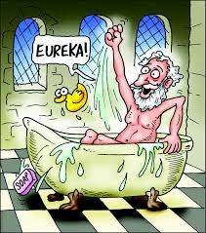
What’s new? Social Reputation
The Wisdom of Crowds: Social Reputation as a classification metric
Facebook, Twitter, Google+1,Pinterest, Linkedin, StumbleUpon
Humans are the best machine learning algorithm

Slide 7







Social Reputation Score
1) Normalization
2) Weighted sum
(weights are important!)
Reputation Score = ((w₁*SR_{Stumble} + w₂ *SR_{Twitter}+ w₃ *SR_{Linkedin}+ w₄ *SR_{Pinterest}+ w₅ *SR_{FbComment}+ w₆ *SR_{FbLike}+ w₇ *SR_{Google}) / 7) * scaling factor
Social Reputation Score
The Right Balance

Slide 8
Our Top 10
Website | Social Reputation Score
amazon.com | 95.2847006
google.com | 94.52254321
aol.com | 93.7759681
wsj.com | 93.57685644
instagram.com | 93.55938731
yahoo.com | 93.37092557
etsy.com | 93.29104733
mlb.com | 93.16139832
elpais.com | 93.015814
tripadvisor.com | 92.99577978

Slide 9
Site Agility
Visual Agility
Source Code Agility

Slide 10
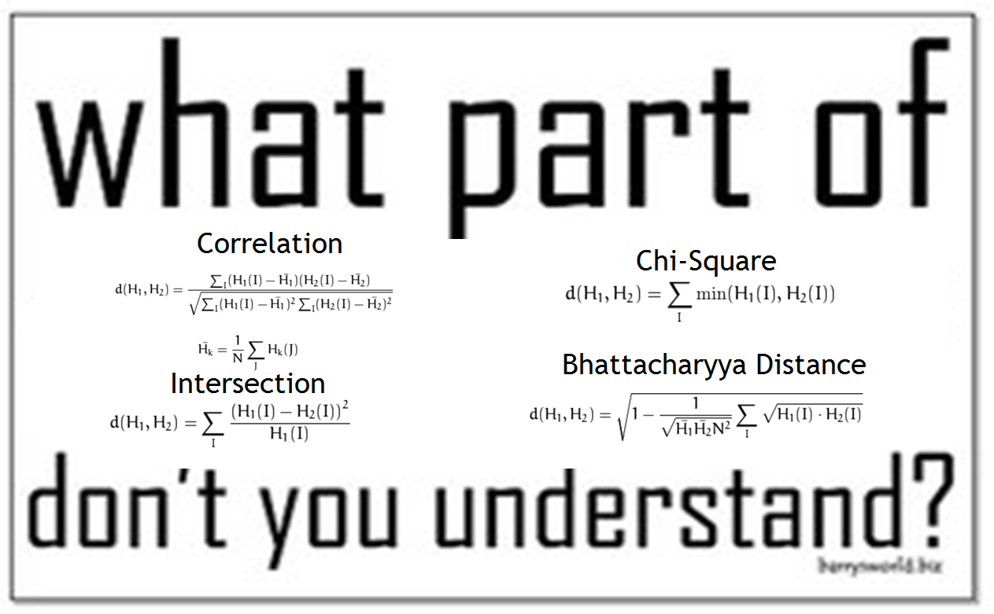
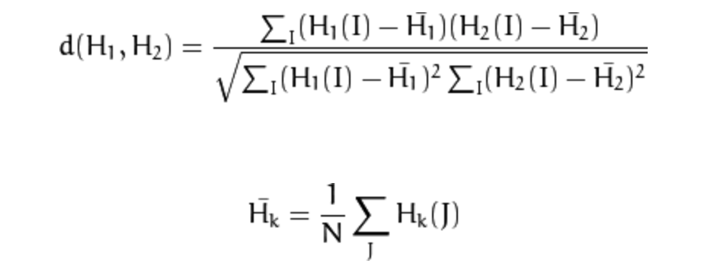
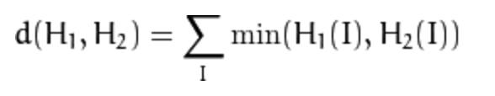
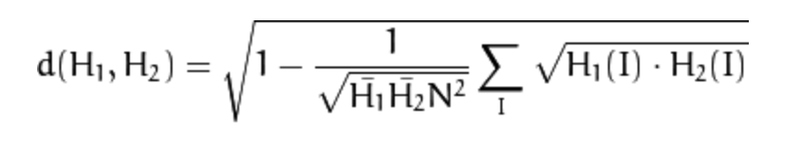
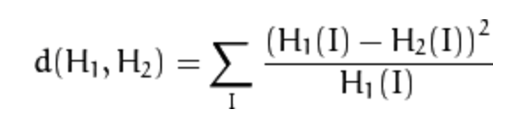
Measuring Image Agility
Correlation
Intersection
Chi-Square
Bhattacharyya Distance

Slide 11
Maybe it’s easier if I just show you what the math is saying

Slide 12
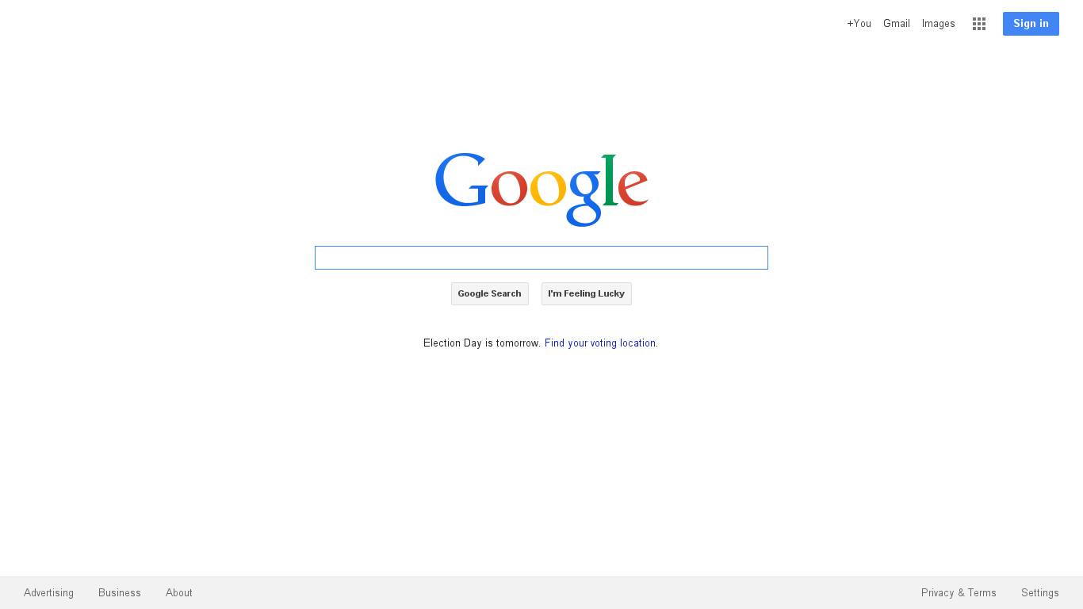
Image Change – Google 10/30

Slide 13
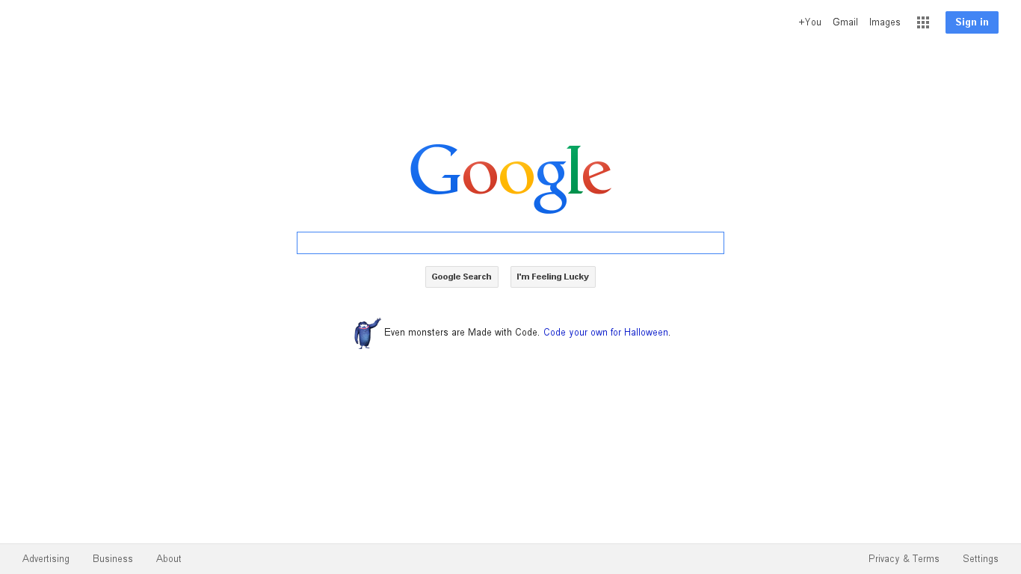
Image Change – Google 11/3

Slide 14
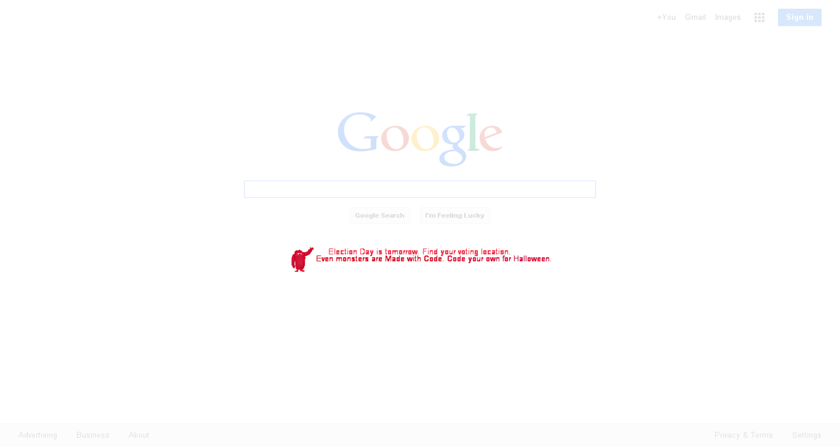
Image Change – Google 10/30 vs 11/3

Slide 15
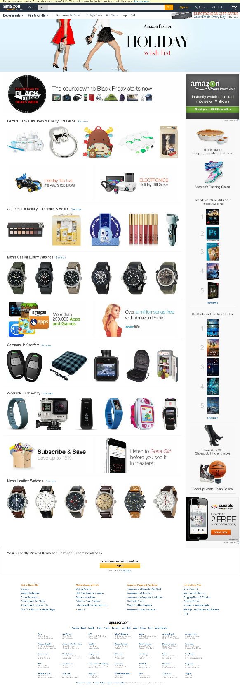

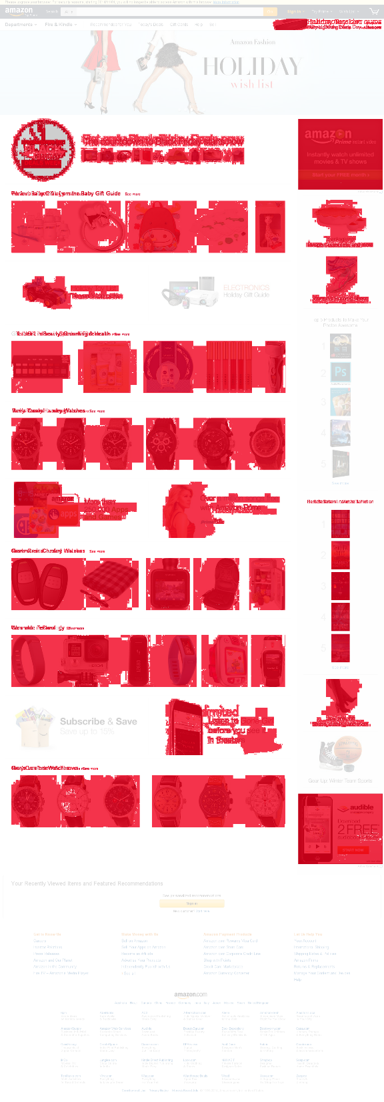
11/7/14
Change
11/8/14

Slide 16
Measuring Source Code Change

Slide 17

Measuring Source Code Change
Absolute Levenshtein distance
Complexity O(n²)
Relative Levenshtein distance
Normalizes Levenshtein Distance

Slide 18
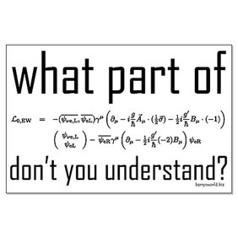
Math as a tool
Mean
Median
Standard Deviation

Slide 19
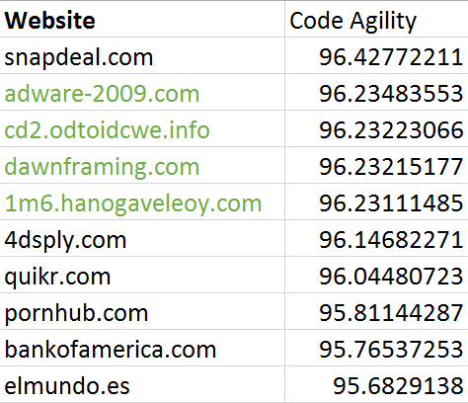
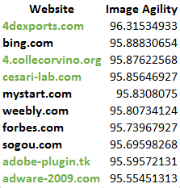
Site Agility Top 10
Key
Black = Benign Sites
Green = Malcious Sites

Slide 20

Additional Features: Links
Total links of
External links
Internal links

Slide 21
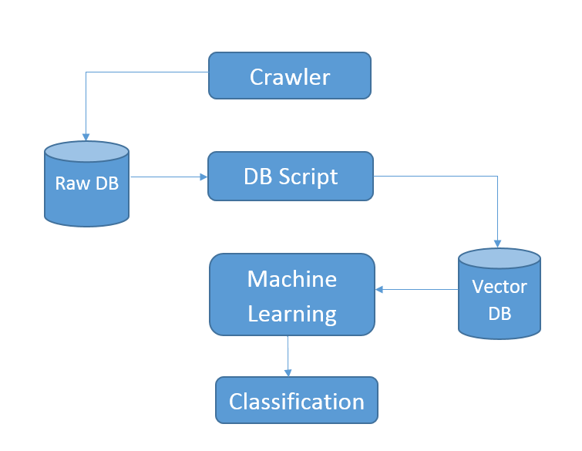
Now on to PopStar

Slide 22
The Brawn

Slide 23
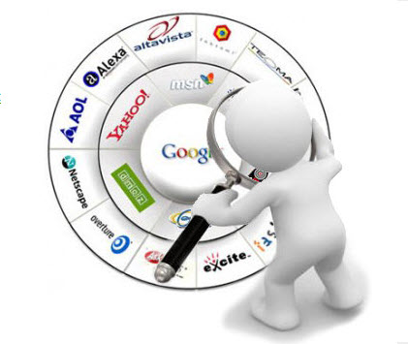
Data Collection- Web Crawler
Implemented via a multi-threaded Python script
Selenium framework
PhantomJS headless webkit
Information is piped into a SQLite database
Crawls 1000 pages per day
Approximately 10 seconds per site

Slide 24

Database
SQLite3 Database
1 write, many concurrent reads
Native to Python
Storing 1 million sites > 80GB (Expensive…Only 100 GB available)

Slide 25
Preprocessing Script
Takes raw data from database
Calculates site agility scores
Extracts code features
Stores in vector database for ML algorithm

Slide 26
The Brain

Slide 27


OUR RECEPIE – 12 Features
Social Metrics (7 cups)
Image Parameters (1 Tblspn)
Source Code (4 ounces)
*Add machine learning according to taste

Slide 28
Why these features?
Features
Image Change
Source Code change
Social Reputation (Absolute Value)
What They Say
Image change is high for News, Video streaming websites
Source code change
A high value suggests its Benign (97% Accuracy)

Slide 29

Ground Truth
The Good
Top 500 Websites from Alexa
The Bad
malwaredomainlist.com

Slide 30
Data Analysis
Considered 2 machine learning algorithms:
Random forest
Bernoulli Naïve Bayes
Random forest gave best results
Algorithm determined relative importance of each feature
 | True Positive | False Positive | Accuracy
Random Forest | 96.6% | 1.7% | 97.8%
Naïve Bayes | 92.1% | 2.6% | 95.7%

Slide 31
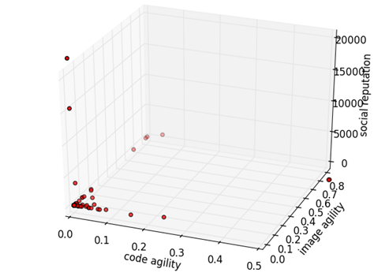
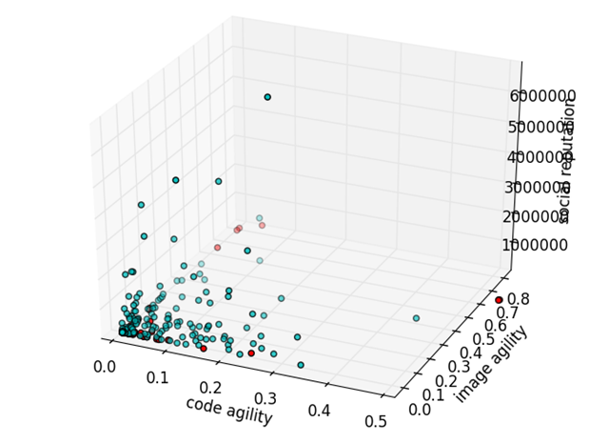
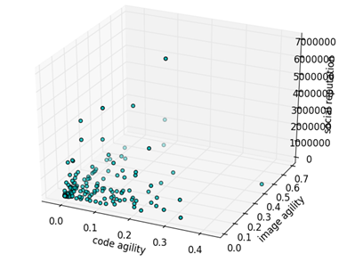
Data Visualization

Slide 32
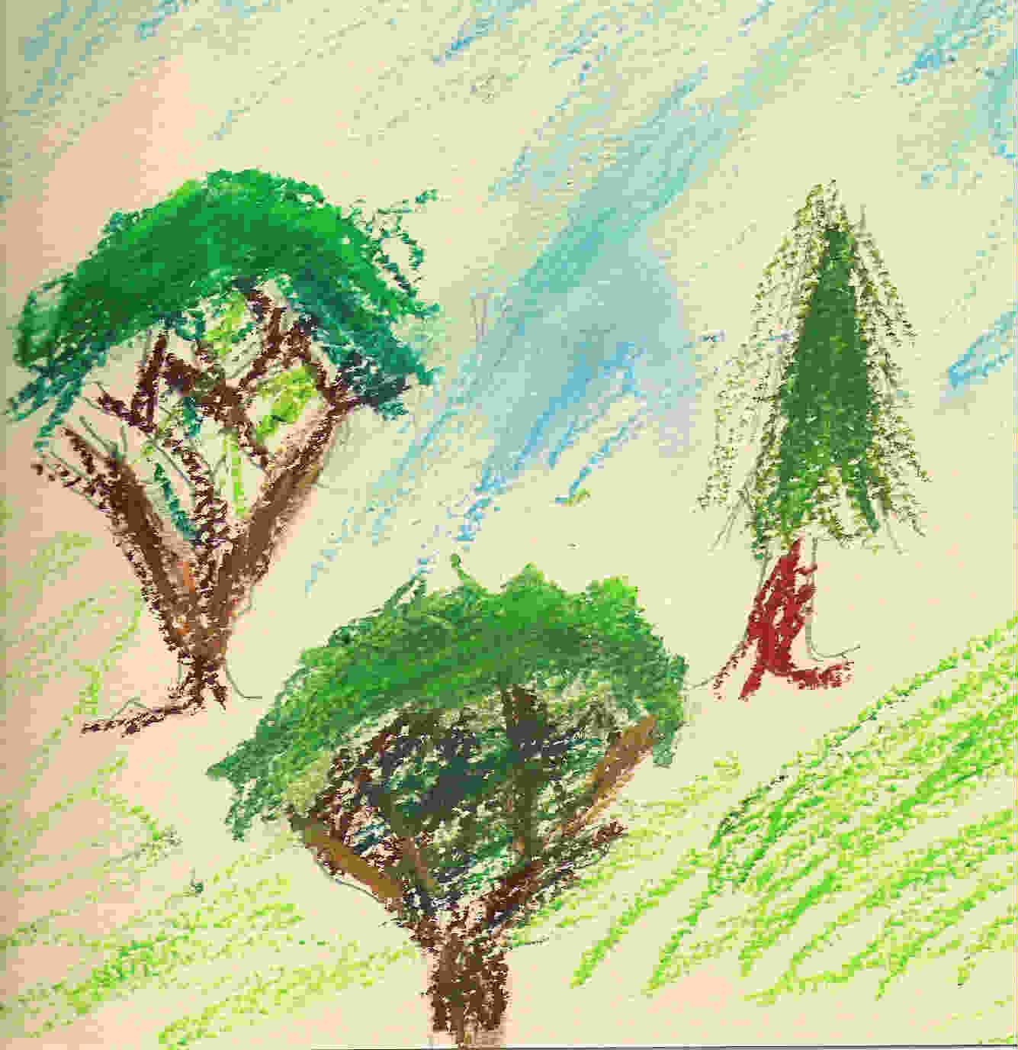
Random Forest

Slide 33
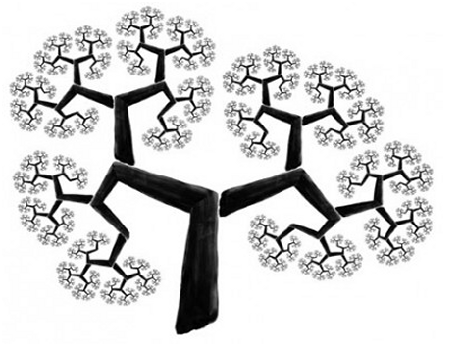
Decision Tree

Slide 34
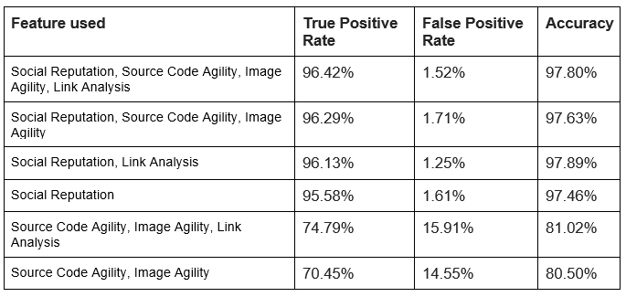
Feature Comparison

Slide 35
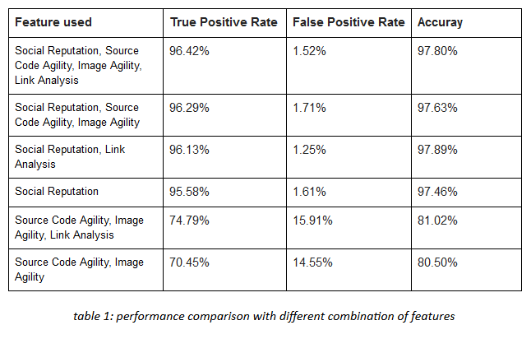
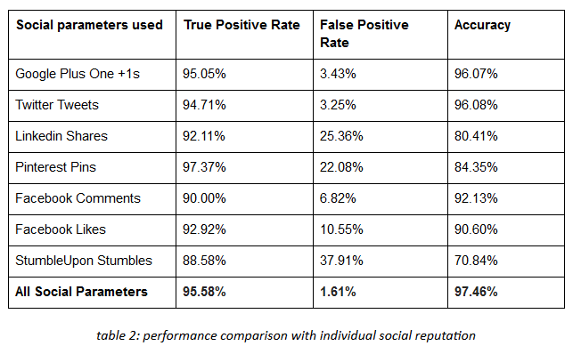
Results from Machine Learning
97.46

Slide 36
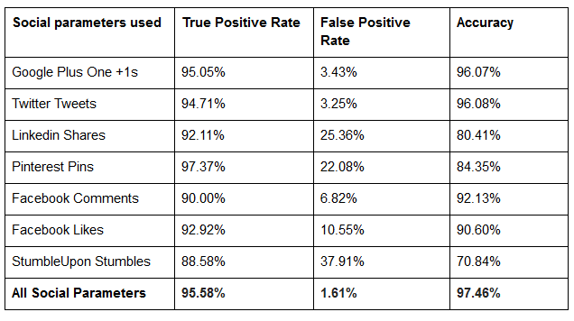
Comparison of Social Metrics

Slide 37
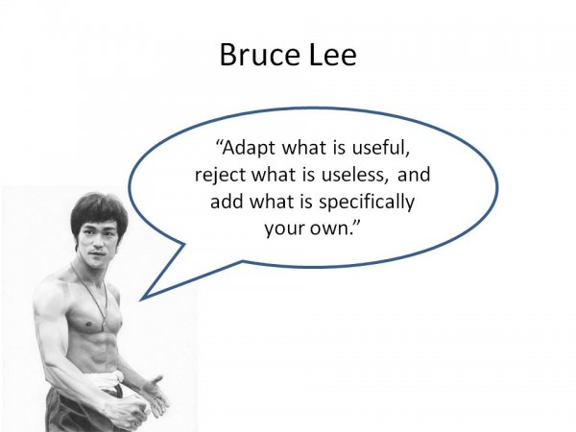

What's useful and what's not?
Social Metrics provide the best results to detect Malicious websites
For websites that are not popular Screenshots, Image Parameters, URL parameters and Source code parameters should be used
Some parameters very useful to detect agility but not always useful to detect malicious websites
Cannot Generalize
AGILITY MALICIOUS

Slide 38
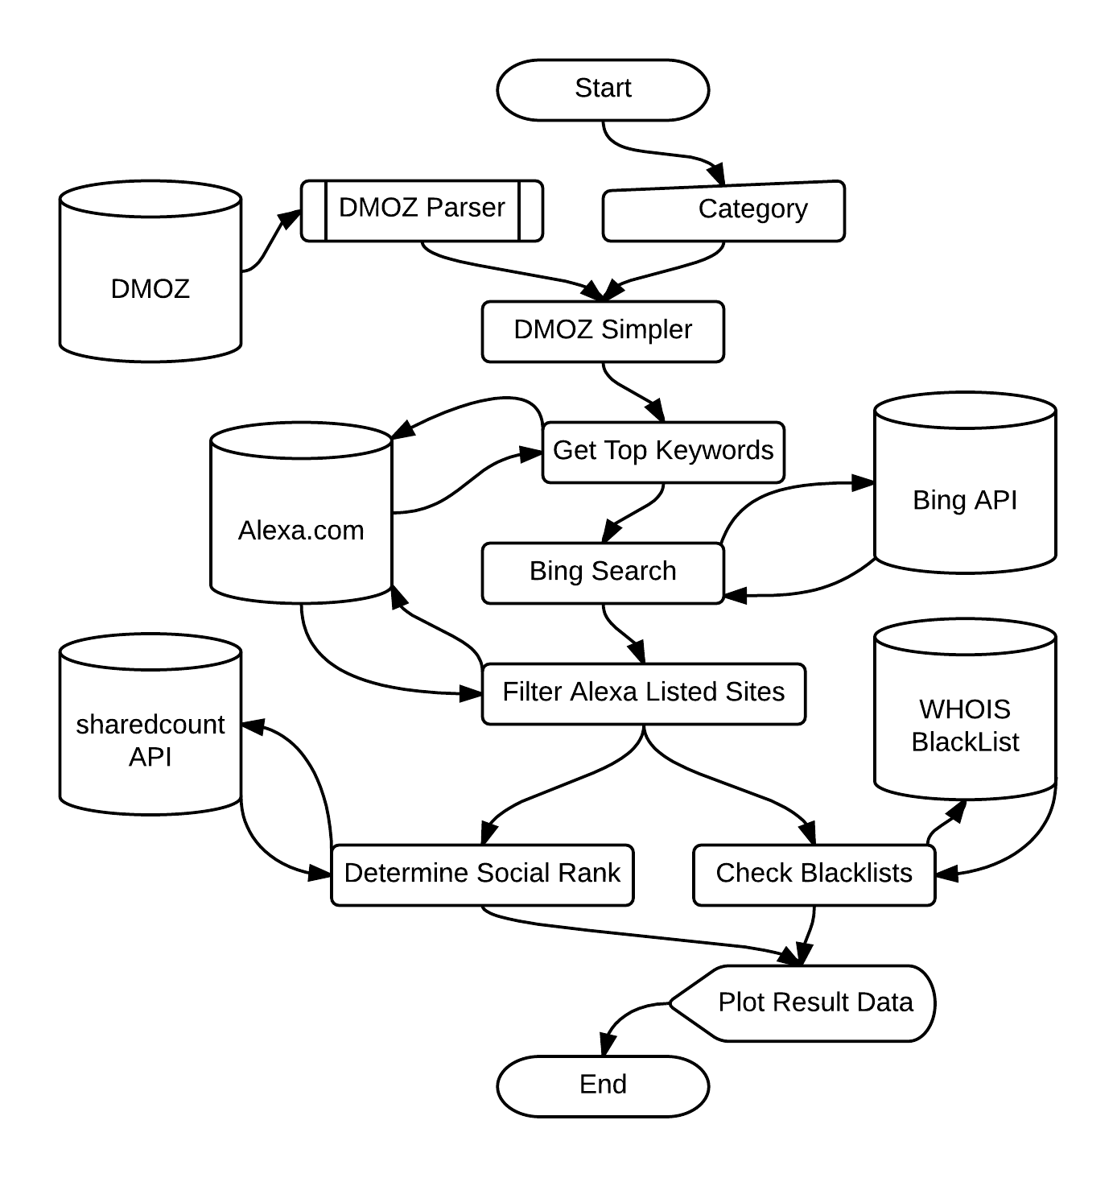
Web API Flow
Categorized Websites: DMOZ
Site Keywords: Alexa
Blacklist: Who.is

Slide 39
Web Search API
Bing API: 5000 queries/month , 50 results/query
1000 results per industry
5-130 websites not on Alexa rank
Search for top 3 keywords
Lesser keywords: Lack characteristics
More keywords: Less results from Search engine
 | Education | Energy | Environment | Food | Football
# not in Alexa | 17 | 38 | 130 | 32 | 5
# in Blacklist | 6 | 18 | 47 | 12 | 3
Percent | 35.30% | 47.40% | 36.20% | 37.50% | 60%

Slide 40

Machine Learning
Social Reputation weights

Slide 41
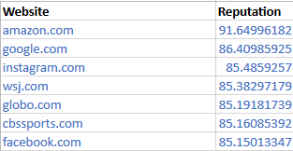

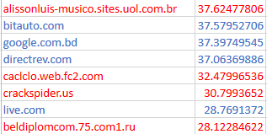
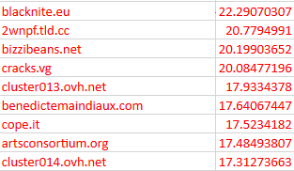
The Malicious ones Pop Up
Sure Safe
Maybe
Sure Unsafe

Slide 42
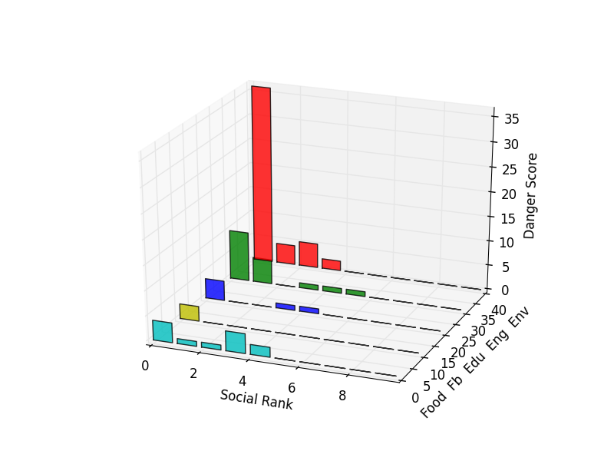
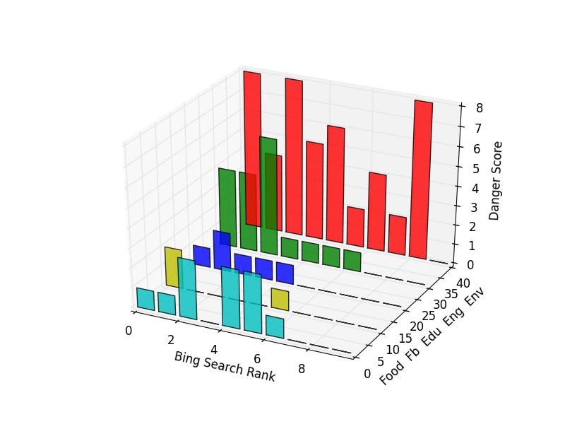
Web API Sample results

Slide 43
Limitations
Malicious sites with high social presence potentially mislabeled as benign (false negative)
Benign sites with no social presence potentially mislabeled as malicious (false positive)
Base Rate Fallacy
Finding active malicious websites difficult
Increasing training set to scale system may create a base rate fallacy if unable to find proportionate number of malicious sites

Slide 44
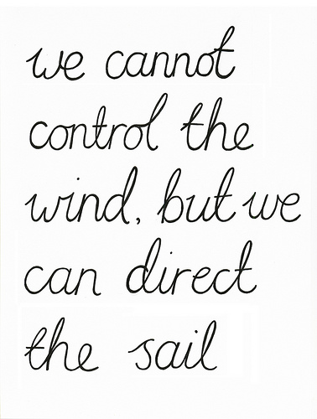
Conclusion
Humans are the best machine learning algorithm
PopStar™ achieves an accuracy of 97.8% with the false positive rate of 1.5%
PopRank™ identified potential waterhole links better than popular search engine

Slide 45


